Slide 1
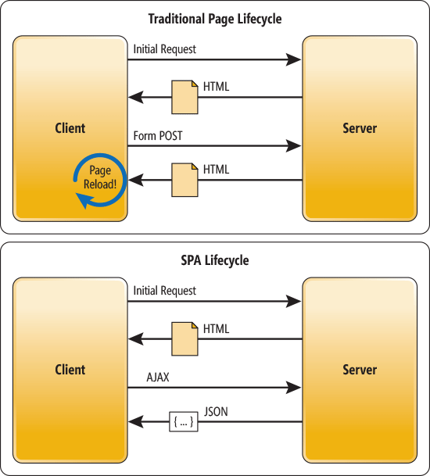
AngularJs + ASP.NET MVC
Hybrid SPA (Single Page Application)

Slide 3
Tools & Libraries
Nuget
AngularJS.Core
AngularJS.Route
bootstrap
jQuery
html5shiv
Respond
Bower
ng-table

Slide 4
Next…
Unit testing
Real-time application using SignalR
Angular UI Bootstrap

